Slide 1
Using the Effort Reporting System
A guide to the required certification of sponsored effort
For questions contact
Jessica Bourne 317-2761 jbourne1@tulane.edu

Slide 2
The Maximus ERS program is Tulane’s method of certifying sponsored effort. This provides Grants and Contracts Accounting an accurate and effective way to provide necessary information during audits and maintains the records required by the government and other sponsors. Tulane requires semi-annual certification: January to June & July to December ERS recognizes those with sponsored effort and creates electronic forms for certification. An effort form cannot be certified until it has been pre reviewed, usually the role of a Department Administrator or the Grant Business Manager. The person to whom the form is assigned for pre review will receive an email when the program goes live each period.

Slide 3
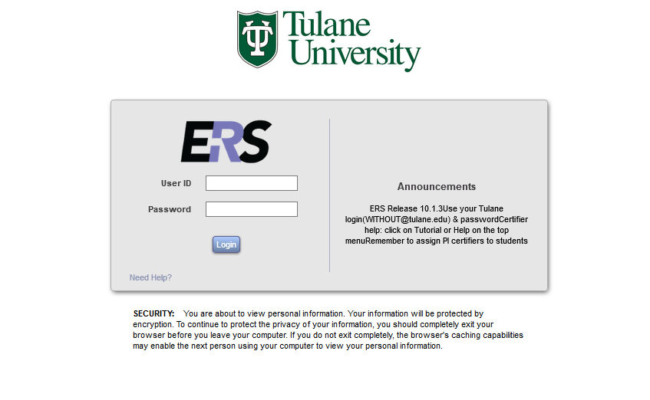
To login, go to http://ers.tcs.tulane.edu/GenericERS and enter your Single Sign-on user id and password. You can access ERS from any device, at any time.

Slide 4
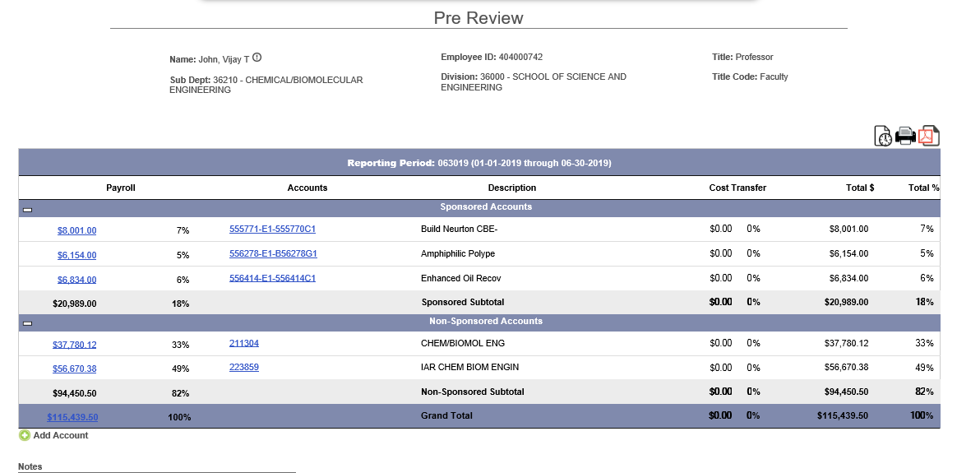
PRE-REVIEWERS
Review each effort form for accuracy
if changes are not needed, proceed and you are done with the pre-review
If changes need to be made, complete a cost transfer (see power point on how to complete a CT)
Utilize ERS resources!
Drill down on each effort form’s payroll to get further detail by clicking the total payroll at the bottom of the pre-review screen
Click on the blue account numbers to get details like PI, home ORG, etc.
123004567
123004567

Slide 5
Other Important Reminders
If you need help with the program, please go to http://tulaneeffortreporting.tulane.edu/index.html for guidance prior to emailing or calling. There is much information available there to help you.
Students do not certify themselves - the PI should do it; change certifier assignments before you do pre review or the incorrect person will receive the auto email from the ERS system.
Do not certify for faculty - you will be held personally responsible for any issues found during an audit. Certify for staff only if you can fully justify a reason why they cannot do it themselves. If someone is termed, the PI or the Chair should be the certifier.
Don't forget to check for summer salary. Click on the total payroll to drill down into the Payroll Detail and look for natural accounts 5252, 5253 and 5254. Please use the notes field to explain to the certifier that summer salary skews the average percentage for the 6-month period.
Use the notes field on the form to explain unusual circumstances like reversals or backpay from a previous period. Always call if you need guidance.
Don’t forget to Log Off when you are done with the program. If not, you will be locked out for 30 minutes.
There is an 6 week deadline for both pre-review and certification. The certifier cannot certify effort forms until the pre-review has been complete. Make sure to allow ample time for certifiers to review all assigned effort forms.

